Slide 1

CNN Based Leaf Detection System and Classification
School of Computer Science and Engineering
Department of Computer Science and Engineering
Submitted By:
Tanveer Singh Chawla
2427030750
Supervised By:
Mr. Tapan Kumar Dey

Slide 2
Outline
Introduction
Literature Review
Problem Statement
Proposed Solution
Objectives
Results

Slide 3
Introduction – Crop Disease Detection
Crop diseases are a major problem in agriculture and reduce crop yield.
Farmers usually detect diseases by visually inspecting plant leaves.
Manual detection is slow, time-consuming, and sometimes inaccurate.
Early and accurate detection is important to prevent crop loss.
Artificial Intelligence can help in fast and automatic disease detection.

Slide 4
Role of AI, Computer Vision and CNN
Computer Vision helps computers analyze leaf images.
Convolutional Neural Networks (CNN) learn disease patterns from images.
In this project, a CNN model is built to detect leaf diseases.
A hybrid approach using Computer Vision and CNN improves prediction accuracy.
Quantum CNN (QCNN) is studied as a future advanced approach.

Slide 5
Literature Review – CNN Based Approaches
Many researchers have used Convolutional Neural Networks (CNN) for plant leaf disease detection.
CNN models can automatically extract features from leaf images.
Studies show CNN achieves high accuracy in identifying crop diseases.
However, CNN models require large datasets and high computational power.

Slide 6
Literature Review – Hybrid Computer Vision + CNN
Recent works combine Computer Vision preprocessing with CNN models.
Techniques like image resizing, normalization, and augmentation improve model performance.
Hybrid CV + CNN models help in better feature extraction and higher accuracy.
This approach makes the model more robust for real-world leaf images.

Slide 7
Literature Review – Introduction to Quantum CNN (QCNN)
Quantum Convolutional Neural Networks (QCNN) are an emerging research area.
QCNN uses quantum computing concepts like qubits and entanglement.
They may require fewer parameters and work well on smaller datasets.
Currently, QCNN is mostly in research stage and not widely implemented.

Slide 8
Problem Statement
Manual detection of crop leaf diseases is slow and sometimes inaccurate.
This project aims to automatically detect leaf diseases using a CNN-based model and explore QCNN as a future advanced approach.

Slide 9
Objectives
Develop a CNN model for automatic leaf disease detection.
Implement a hybrid Computer Vision + CNN approach for better accuracy.
Analyze the concept of Quantum CNN (QCNN) for future improvements.
Compare classical CNN with the idea of QCNN in agriculture applications.

Slide 10
Proposed Methodology
Step 1: Data Collection and Preprocessing
Leaf images are collected from the PlantVillage dataset.
Images are resized and normalized for consistent input.
Data augmentation like rotation and flipping is applied.
This improves model generalization and accuracy.

Slide 11
Proposed Methodology
Step 2: CNN Model for Disease Detection
A Convolutional Neural Network (CNN) is built from scratch.
Convolution layers extract important leaf features.
Pooling layers reduce dimensions and noise.
Fully connected layers classify the disease type.

Slide 12
Proposed Methodology
Step 3: Hybrid Computer Vision + CNN Approach
Computer Vision techniques preprocess the images.
Feature enhancement improves important disease patterns.
The processed images are then passed to the CNN model.
This hybrid approach improves detection performance.

Slide 13
Proposed Methodology
Step 4: Concept of Quantum CNN (QCNN)
QCNN uses quantum computing concepts like qubits and entanglement.
It may learn complex patterns using fewer parameters.
Currently, QCNN is studied as a future research extension.
Implementation is limited due to hardware and complexity.

Slide 14
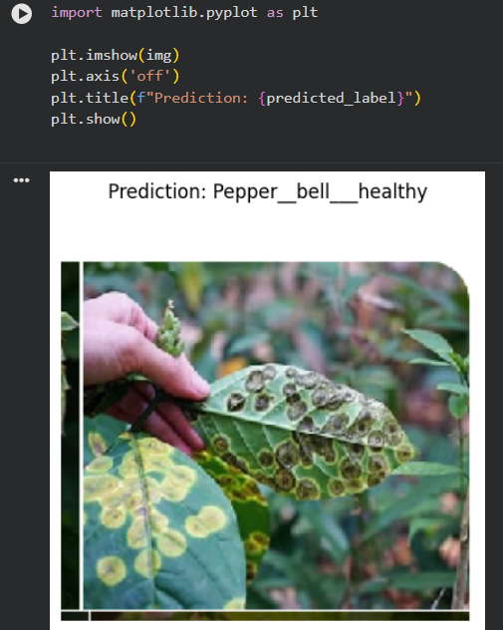
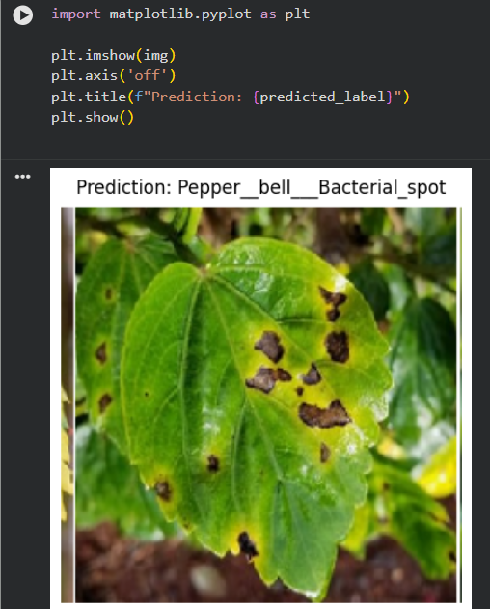
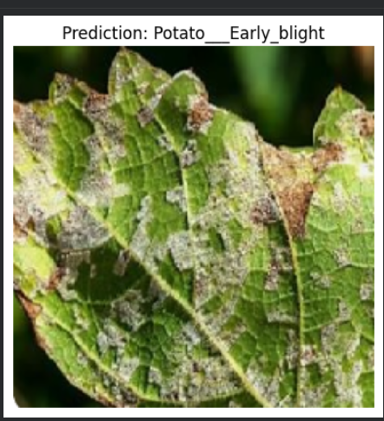
Result

Slide 15
Outcome
• Research Paper: Draft in progress based on CNN vs QCNN comparative study
• Patent: Not filed yet (planned after full QCNN implementation)
• Copyright: Planned for model architecture and project report
• Real Time Deployment: Partially completed (CNN model trained and tested on leaf dataset; hybrid CV + CNN pipeline implemented)
Current Achievement: Successfully developed and tested a CNN-based leaf disease detection model and studied QCNN as future enhancement.

Slide 16
References
1. Mohanty, S. P., Hughes, D. P., & Salathé, M. (2016).
Using Deep Learning for Image-Based Plant Disease Detection.
2. Ferentinos, K. P. (2018).
Deep Learning Models for Plant Disease Detection in Agriculture.
3. PlantVillage Dataset.
Public dataset for plant leaf disease classification.
4. Schuld, M., & Killoran, N. (2019).
Quantum Machine Learning with Quantum Feature Maps.

Slide 17
Thank You

